Slide 1
SHOBOT WEEKLY REPORT
J JAYAGOWTHAM
ME21B078

Slide 2
EXCEL SHEET OF THE ITEMS PRESENT IN THE ARENA
Prepared an excel sheet of the items present in the arena. (See Fig.1)
Manually took the items and collected the data.
It included the barcode number, name of the product, weight, price and expiry date.

Slide 3
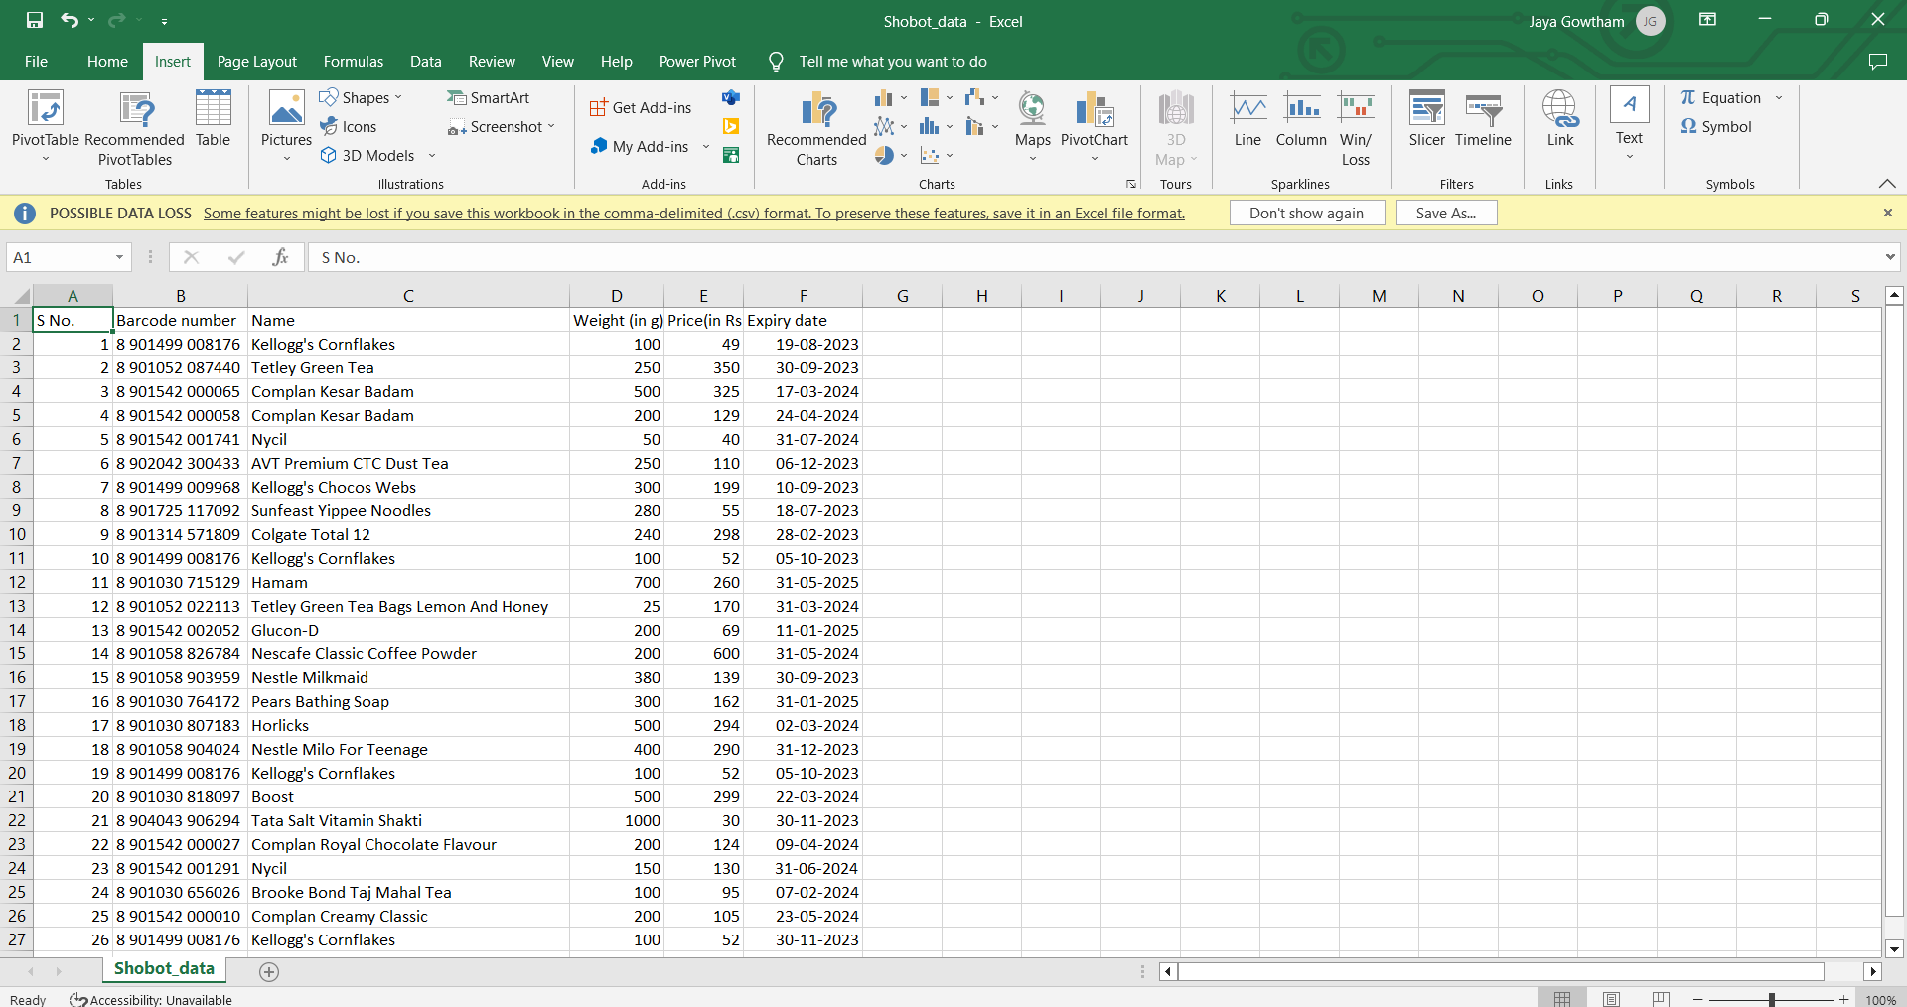
Fig.1 Excel Sheet

Slide 4
PANEL APPLICATION FOR THE EXCEL SHEET
Learnt about the various methods in which panel can be used for our requirement
Developed a panel application for the excel sheet. (See Fig. 2)
The aim of the application is to retrieve the information of any item whose barcode number we provide.
The application is referenced to the excel sheet we earlier created.
Used a basic template called “Bootstrap” for the design of the application
Included interactive widgets to run the app dynamically

Slide 5
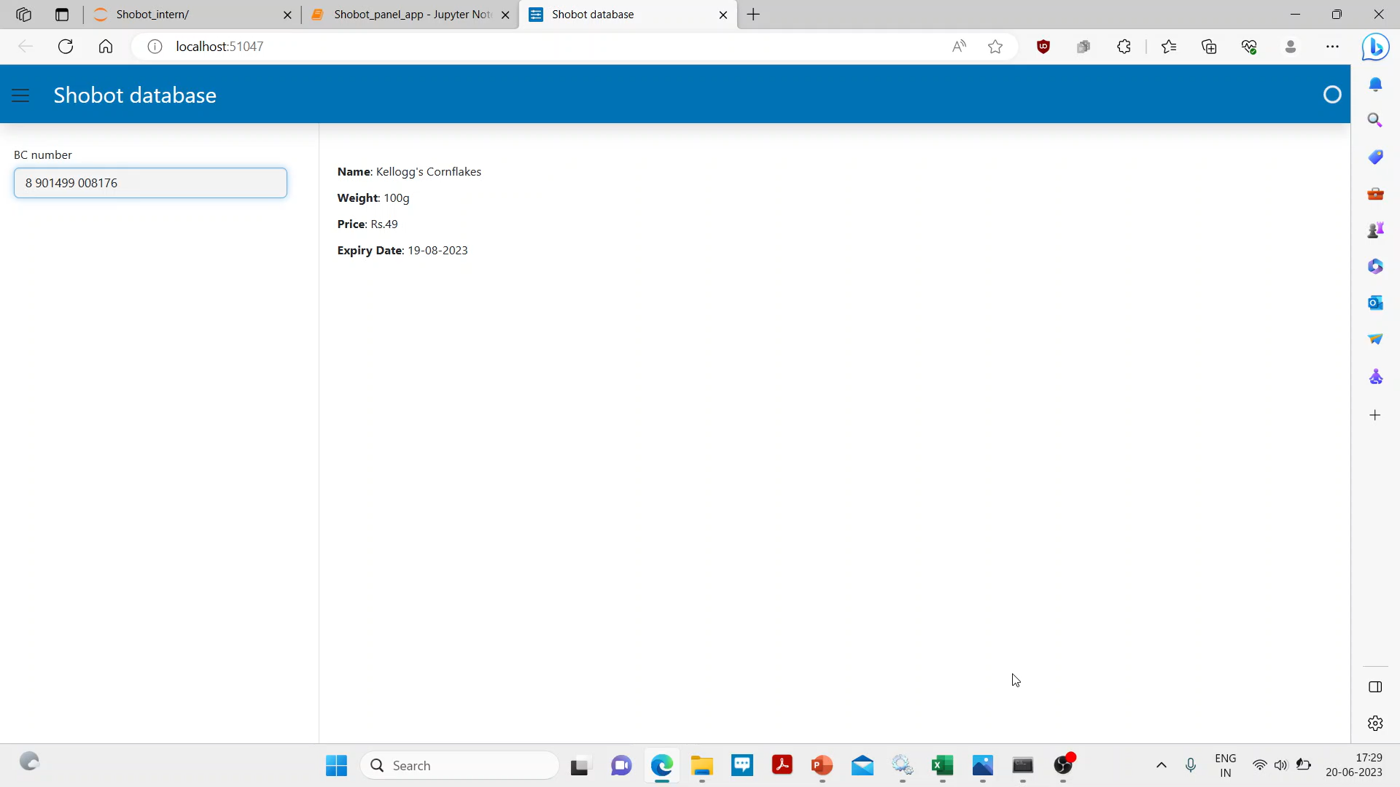
Fig. 2 Panel App

Slide 6
ARGUMENT PARSING AND FILE MANAGEMENT
Learnt argument parsing in python. (see Fig. 3)
Argument parsing is basically collecting arguments from command line and interpreting it by parsing
It is helpful for creating an image dataset
Learnt File management in python using os module (see Fig. 4)
It will help you in operations on your current directory such as creating a file or directory, opening a file by path, list of documents available on a given path using a python script
Will be helpful for creating an image dataset and storing it
Please refer to the link below for all the resources
https://drive.google.com/drive/folders/16DtAhneJsPgL2oklSCFmVQQ4dyTevlGR?usp=drive_link

Slide 7
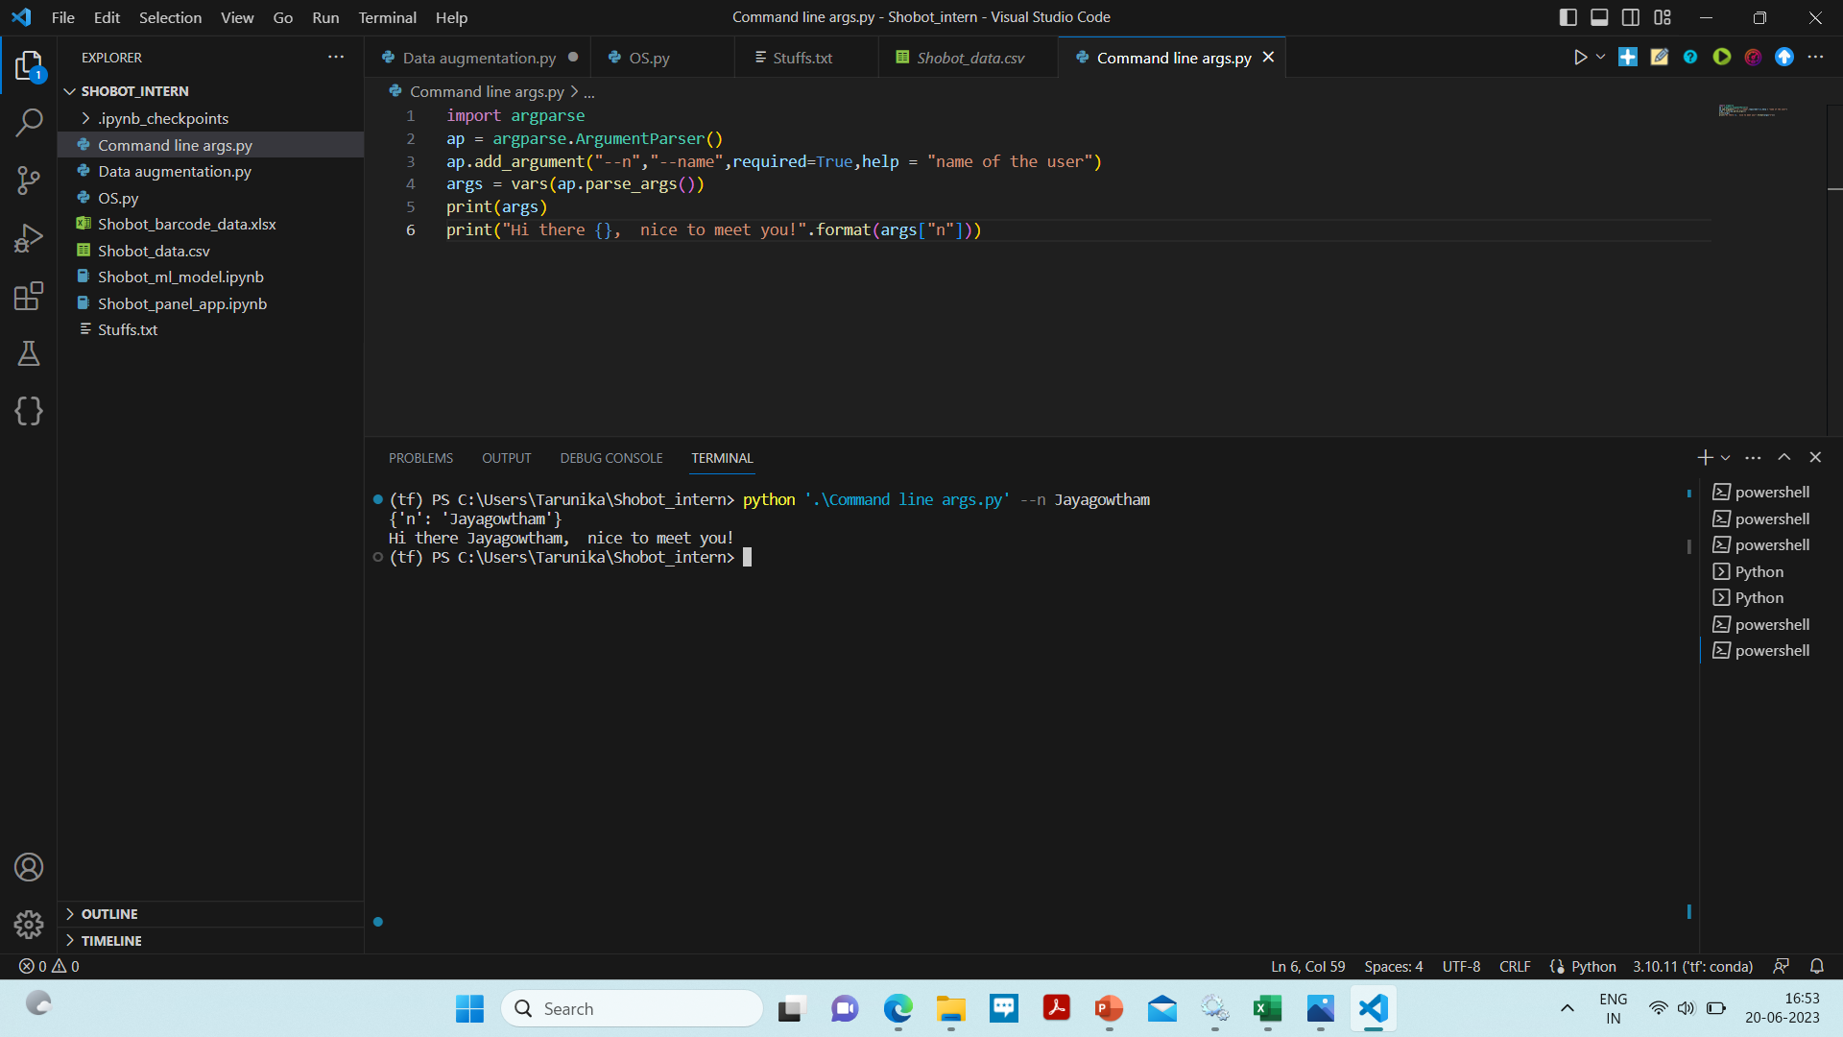
Fig. 3 Argument Parser

Slide 8
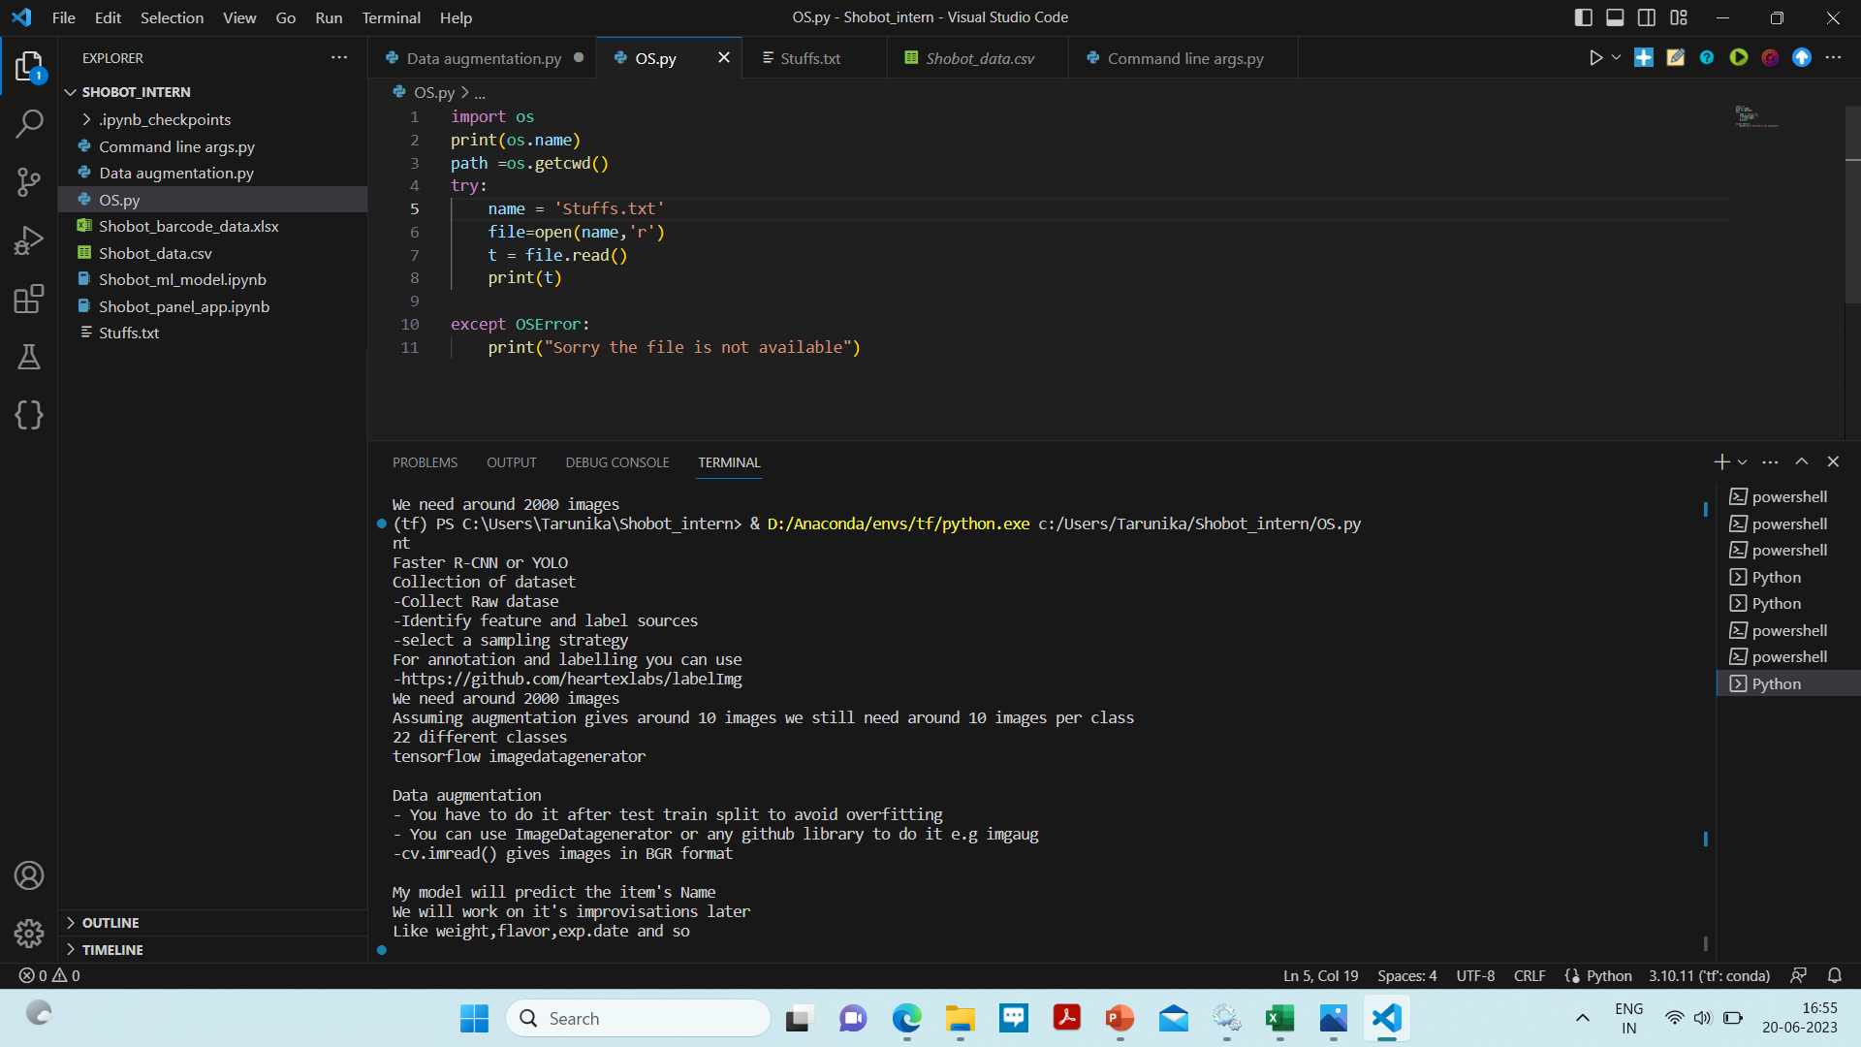
Fig. 4 OS library

Slide 9
PLAN FOR NEXT WEEK
Create a dataset of images of objects present in our arena.
Augment it based on data augmentation techniques
Understand how conventional CNN models like RCNN and YOLO work

